Slide 1

Deconstructing Deconstruction
A Presentation for the
Bill DuVall, ThM, PhD
Dean – College of Arts & Sciences
Professor of Psychology
Southwest Baptist University

Slide 2
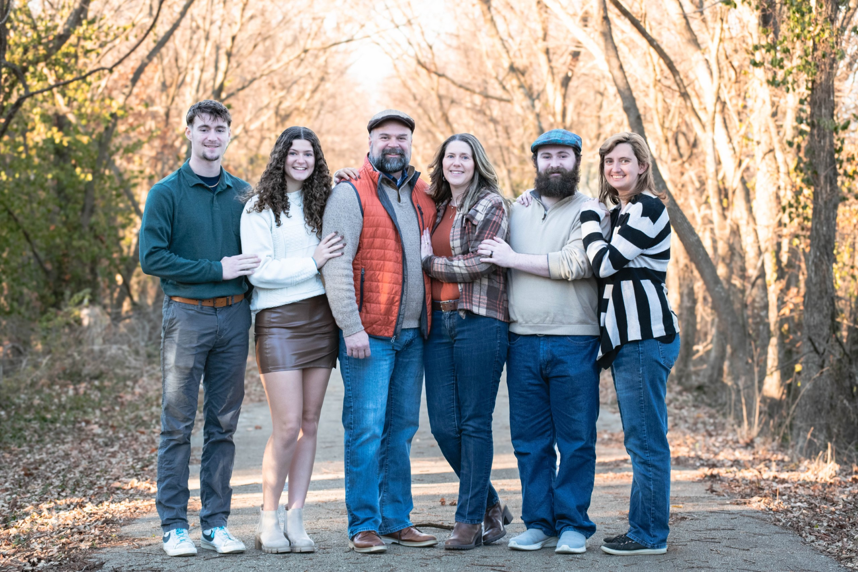
About me
Psychology professor since 2015
Dean – College of Arts & Sciences
Executive Director – Blair Center for Training and Pastoral Health
Married to Julie for 29 years
3 kids: Elijah (Grace), Aidan (Madeline – not pictured), & Abbey

Slide 3
Learning objectives
Participants will:
Identify and comprehend the stages of faith identity formation and recognize their role in the lives of adherents.
Analyze deconstruction and contrast current views of deconstruction with healthy faith identity formation in the stage of arrested faith with special consideration given to faith transforming events and their role in moving from one stage to the next.
Identify and understand assessment skills aimed at determining a client's faith identity stage to be able to discuss deconstruction with them. These skills will include specific questions to ask as well as use of the Faith Identity Test.

Slide 4
An Explanation by Example
Notes:
Savin-Williams article on Sexual Orientation processes from 2007
Attraction (Internal Feelings)
Behavior (Actions)
Identity (Self-Labeling)

Slide 5
How faith develops
Faith Development Theories
vs.
Faith Identity Theory

Slide 6
Prominent Theories – Fowler
Fowler
Intuitive-Projective
Mythic-Literal
Synthetic-Conventional
This is the stage of preschool children in which fantasy and reality often get mixed together. However, during this stage, our most basic ideas about God are usually picked up from our parents and/or society.
When children become school-age, they start understanding the world in more logical ways. They generally accept the stories told them by their faith community but tend to understand them in very literal ways. [A few people remain in this stage through adulthood.]
Most people move on to this stage as teenagers. At this point, their life has grown to include several different social circles and there is a need to pull it all together. When this happens, a person usually adopts some sort of all-encompassing belief system. However, at this stage, people tend to have a hard time seeing outside their box and don't recognize that they are "inside" a belief system.
Notes:
Synthetic-Conventional - At this stage, authority is usually placed in individuals or groups that represent one's beliefs.
[This is the stage in which many people remain.]

Slide 7
Prominent Theories - Fowler
This is the tough stage, often begun in young adulthood, when people start seeing outside the box and realizing that there are other "boxes". They begin to critically examine their beliefs on their own and often become disillusioned with their former faith.
Individuative-Reflective
Conjunctive
Universalizing
It is rare for people to reach this stage before mid-life. This is the point when people begin to realize the limits of logic and start to accept the paradoxes in life. They begin to see life as a mystery and often return to sacred stories and symbols but this time without being stuck in a theological box.
Few people reach this stage. Those who do live their lives to the full in service of others without any real worries or doubts.
Notes:
Individuative-Reflective: Ironically, the Stage 3 people usually think that Stage 4 people have become "backsliders" when in reality they have actually moved forward.
Universalizing – Mother Teresa, Ghandhi
Also mention Allport’s Intrinsic (good) vs. Extrinsic (bad) religious orientation.

Slide 8
Prominent Theories - Peck
People stuck at this stage are usually self-centered and often find themselves in trouble due to their unprincipled living. If they do end up converting to the next stage, it often occurs in a very dramatic way.
Chaotic-Antisocial
Formal-Institutional
Skeptic-Individual
Mystic-Communal
At this stage people rely on some sort of institution (such as a church) to give them stability. They become attached to the forms of their religion and become extremely upset when these are called into question.
Those who break out of the previous stage usually do so when they start seriously questioning things on their own. A lot of the time, this stage ends up being very non-religious and some people stay in it permanently
People who reach this stage start to realize that there is truth to be found in both the previous two stages and that life can be paradoxical and full of mystery. Emphasis is placed more on community than on individual concerns.
Notes:
The Road Less Traveled
Theory from A Different Drum
(Criminal) Similar to Fowler’s 1&2
(Rules-Based) Similar to Fowler’s 3
(Rebellious) Similar to Fowler’s 4
(Mystery) Similar to Fowler’s 5&6 [Many at Peck’s stage 3 don’t realize there is a stage 4.

Slide 9
Critique
Simple Linear Design
  Belief yields actions with no other factors
Unilateral Direction
  Only moving forward or stagnation
Age-Graded Development
  A purely developmental model does not leave sufficient room for spiritual development
Notes:
Jones and Wilder argue that what Fowler may actually be describing is development of Wisdom
No concept of need to persevere in faith to move forward. No possibility of other variables besides Beliefs and Corresponding Actions

Slide 10
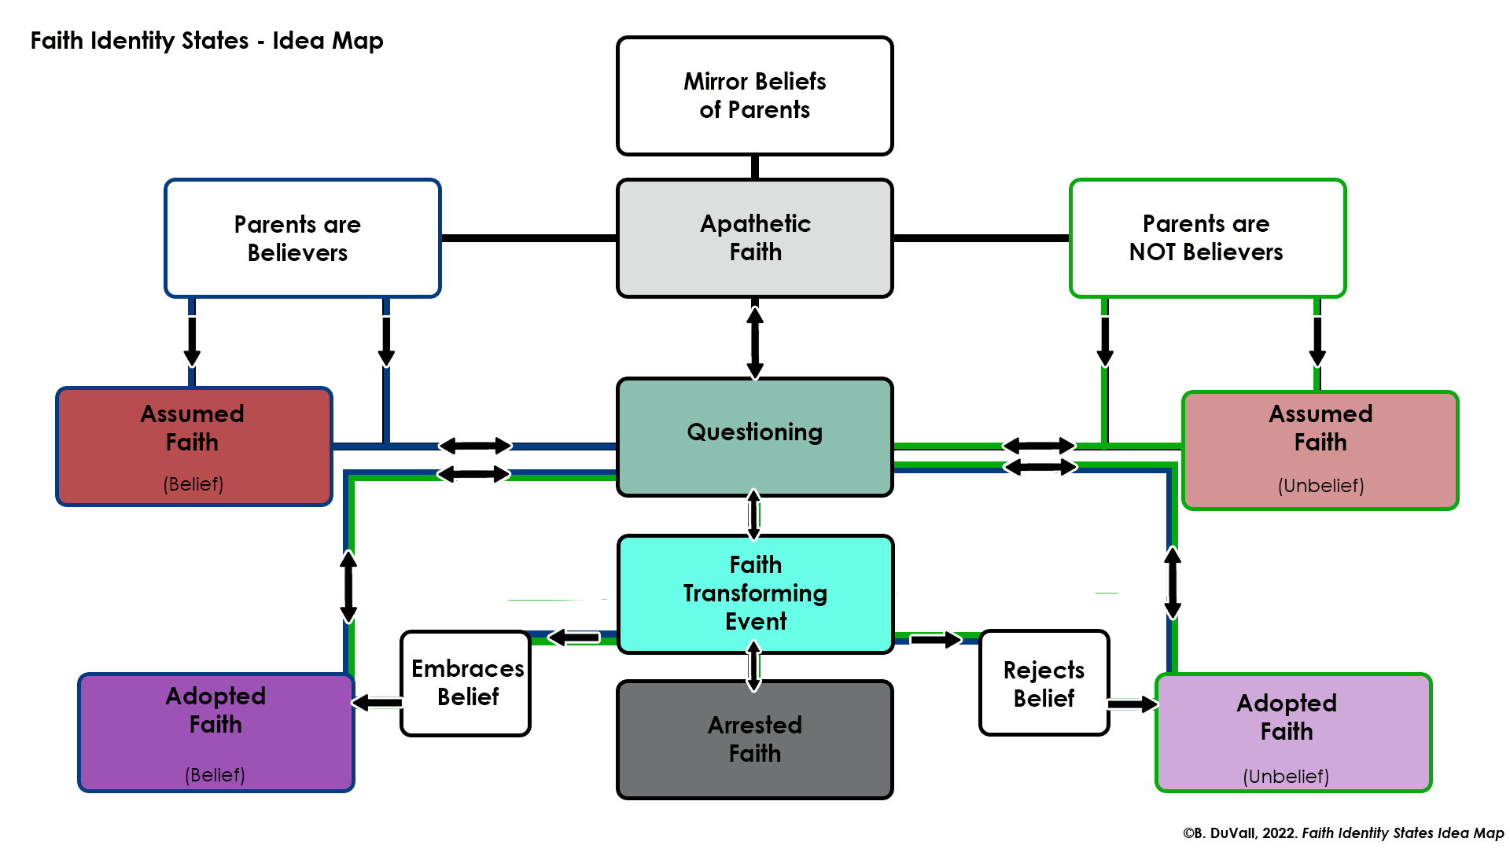
Faith Identity States – Idea Map

Slide 11




Faith Identity States

Slide 12
Low Exploration
Low Commitment
This individual is not currently concerned with things of faith.
Apathetic Faith
And as he sowed, some seed fell along the path, and the birds came and devoured it.
Mark 4:4

Slide 13
Low Exploration
Stronger Commitment
This individual has not experienced challenges to their beliefs.
Assumed Faith
Other seed fell on rocky ground, where it did not have much soil, and immediately it sprang up, since it had no depth of soil. ⁶ And when the sun rose, it was scorched, and since it had no root, it withered away.
Mark 4:5-6

Slide 14
High Exploration
Reduced Commitment
This individual is struggling with prior held beliefs. They are actively exploring alternatives.
Arrested Faith
Other seed fell among thorns, and the thorns grew up and choked it, and it yielded no grain.
Mark 4:7

Slide 15
Completed Exploration
Strong Commitment
This individual has worked through their questions and holds strongly to their beliefs.
Adopted Faith
And other seeds fell into good soil and produced grain, growing up and increasing and yielding thirtyfold and sixtyfold and a hundredfold.
Mark 4:8

Slide 16

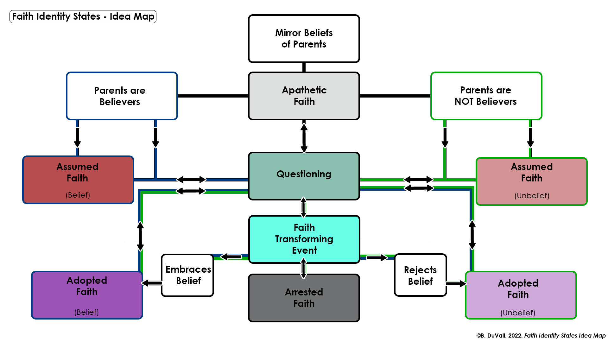
Other seed fell among thorns, and the thorns grew up and choked it, and it yielded no grain.
Mark 4:7
It’s about the Crisis

Slide 17
Crisis
Faith Transforming Event
Faith Informing Moment
A Faith Transforming Event (FTE) is a macro-transaction where an individual is no longer able to reconcile prior beliefs due to new information the individual either voluntarily discovered or involuntarily confronted.
  Can happen at any time
  Always leads to questioning
  Can happen more than once
  Can happen through vicarious exposure
Faith Informing Moment – micro-transaction where an individual’s prior beliefs are reaffirmed or confronted in ways that do not lead to questioning (hearing a sermon, praise song, story that either lines up with or subtly challenges current beliefs)
Can happen at any time
If enough occur, these can lead to questioning

Slide 18
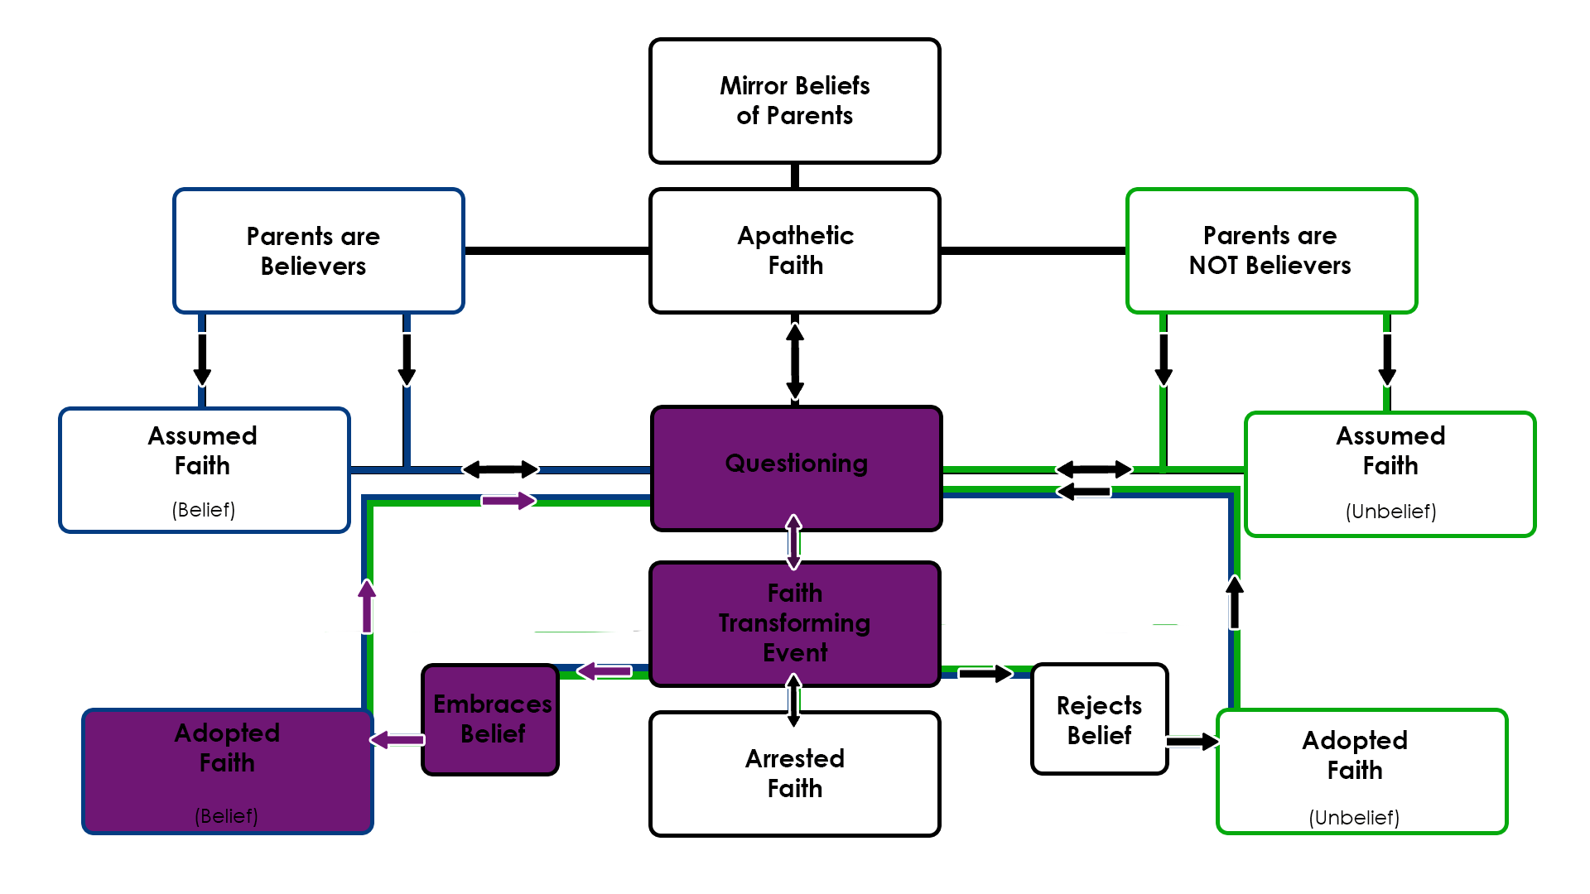
Faith Identity States
The Path of Perseverance

Slide 19
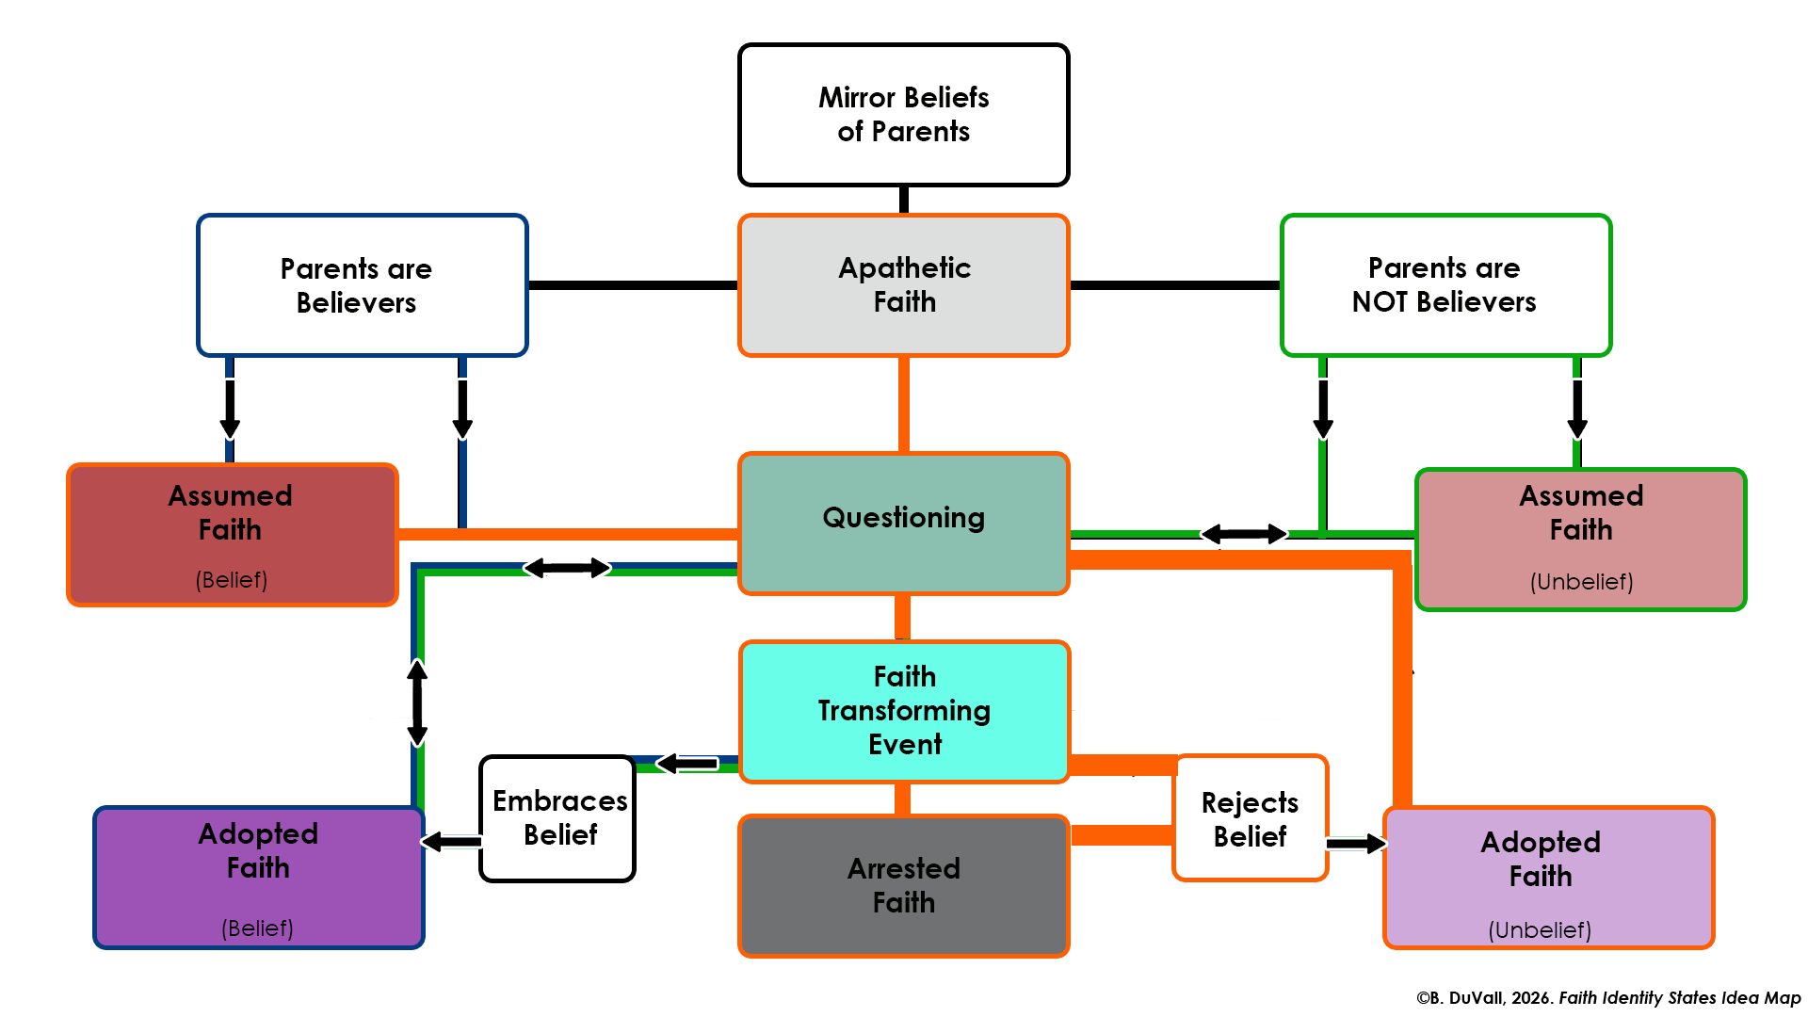
Faith Identity States
The Path of Deconstruction?
DECONSTRUCTED

Slide 20
defining deconstruction
Three Views

Slide 21
Defining Deconstruction - Derrida
Ideas first came to the US in the 1970s and taken more seriously in the 1980s
What Deconstruction is not - an ideological entity unto itself
What Deconstruction is - the argument that ideological entities should not exist

Slide 22
Defining Deconstruction - Derrida
If one is honest about a core ideology and its boundaries, as well as the influences of other ideologies on any particular chosen ideology, then one must conclude that no chosen ideology is pure enough in its construction to stand alone.
Therefore, the best pathway forward is to stop looking at black & white constructions and live in the shades of gray.
This chaotic avoidance of ideological entity is at the heart of deconstruction.

Slide 23
Defining Deconstruction - Derrida
The problem of the ideal
Within Faith Identity, One can imagine faith identity as it should be and recognize a comparison to one's own faith identity as it is - at its core, separate from the ideal.
  For Derrida, this separation demands deconstruction.
The significant underpinning here is that there exists a separate other, perfect ideal in the person of Jesus Christ and the authority of His Word. This objective ideal is a standard, THE standard, by which faith identity must be measured, and thus grants Him authority over construction as the "author and perfecter of our faith."
Notes:
Ironically, from Derrida's argument, this recognition should promote unity. The recognition of separation from the ideal should open up possibilities toward unity through humble acceptance of a universal absence of meeting the ideal standard. As we know, however, since Jesus is not universally recognized as the objective ideal, and as we move toward individual interpretations of what faith means and how faith works, disunity remains.

Slide 24
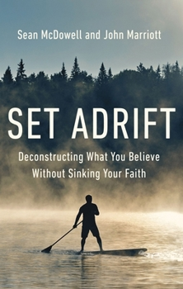
Defining Deconstruction – McDowell and Marriott
They start by addressing three definitions
  Derrida
  #exvangelicalism (idea of toxic religiosity leading to “Toss Everything”)
  Their core definition
    “A process of analysis that Christians who want to follow Jesus engage in because they "doubt the faith they've received is the fully refined good that God intends and are seeking to sift out the dross and keep what is most precious."

Slide 25
Faith Identity States
The Path of Deconstruction?
DECONSTRUCTED

Slide 26
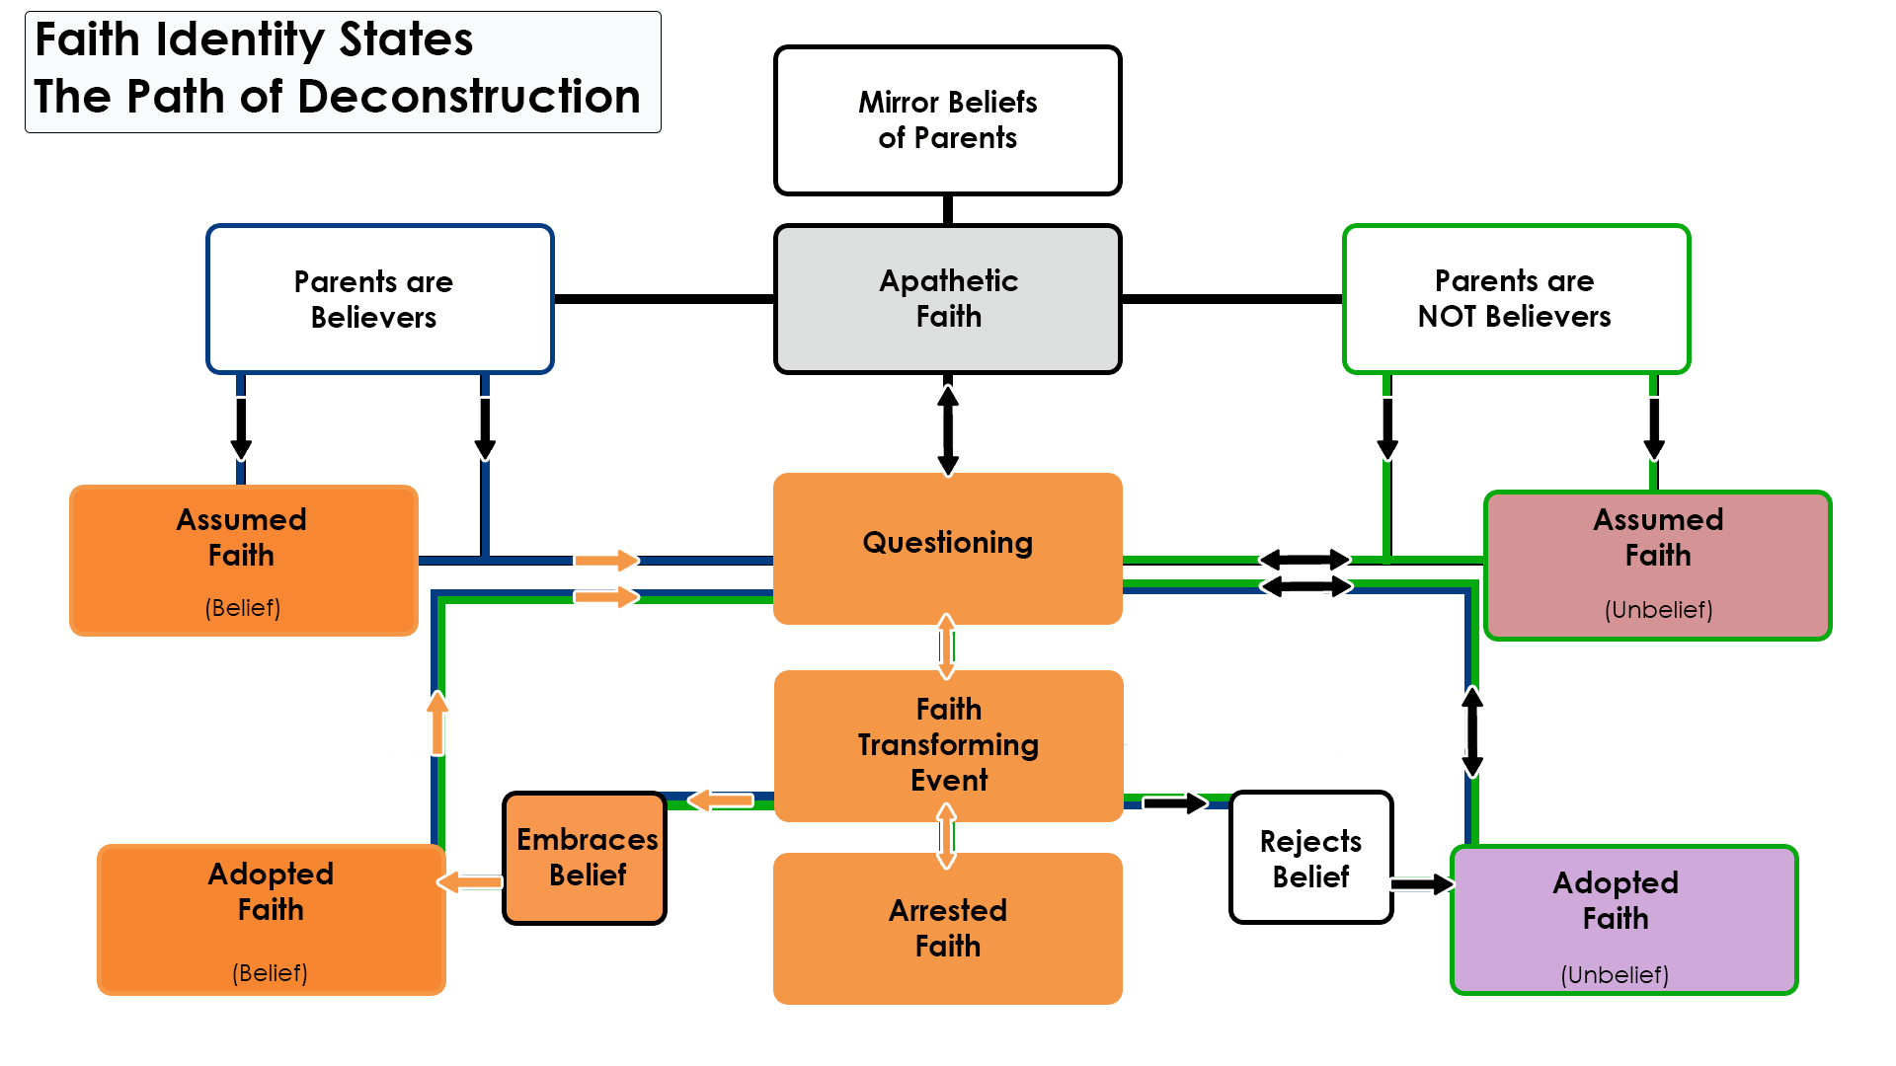

Slide 27
Defining Deconstruction – McDowell and Marriott
  In other words,
Deconstruction
≠
Deconversion

Slide 28
Defining Deconstruction – McDowell and Marriott
Deconstruction involves a “re-forming” of faith
Benefits
  A Healthier Faith
  A Genuine Faith
  A Truthful Faith

Slide 29
Defining Deconstruction – McDowell and Marriott
Deconstruction involves a “re-forming” of faith
Risks
  Apostasy
  Heresy
  Demolition

Slide 30
Defining Deconstruction – McDowell and Marriott
  Deconstruction involves a “re-forming” of faith
  This involves a couple key variables
    Cognitive Dissonance
    Emotional Unrest
  This begins the move toward Paradigm Shift

Slide 31

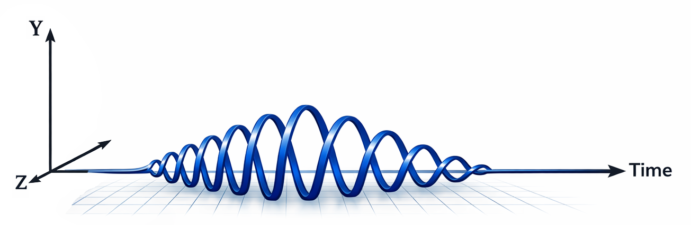
Defining Deconstruction – Paradigm Shift
  Stages of Paradigm Shift
    Ignorant Unconcern
    Curiosity (Initial FTE)
    Heightened Curiosity (Crisis expands)
    Cognitive Dissonance
    Emotional Unrest
    Questioning (Exploration increases)
    Choice Selection
    Cognitive/Emotional Consonance
    Sated Curiosity
    Informed Unconcern
Notes:
Initial base in Prochaska and DiClemente’s Stages of Change and Egan’s longer description of Client readiness for change model

Slide 32
Defining Deconstruction – McDowell and Marriott
  The authors emphasize the importance of rightly understanding Jesus's identity.
  p.35 - “Your conclusions about the identity of Jesus are the most important thing about you."
  The main argument here is that any deconstruction or reconstruction of Christianity must retain two basic components - A right understanding of Jesus as Son of God, and a right understanding of Jesus as Lord. Getting either of these wrong moves one outside the bounds of Christianity.

Slide 33
Defining Deconstruction – McDowell and Marriott
Dogma and Doctrine play a necessary role in Deconstruction
Dogma is a needed (outer) fence. Outside this fence, one is no longer truly a Christian because what they believe, no matter how sincerely they believe it, is beyond reasonable historical orthodoxy
Doctrine is the Christian pasture. People can disagree on doctrine and both still be Christians.

Slide 34
Defining Deconstruction – McDowell and Marriott
Dogma and Doctrine play a necessary role in Deconstruction
Dogma is a needed (outer) fence. Outside this fence, one is no longer truly a Christian because what they believe, no matter how sincerely they believe it, is beyond reasonable historical orthodoxy
Doctrine is the Christian pasture. People can disagree on doctrine and both still be Christians.

Slide 35
Defining Deconstruction – McDowell and Marriott
Dogma and Doctrine play a necessary role in Deconstruction
Dogma is a needed (outer) fence. Outside this fence, one is no longer truly a Christian because what they believe, no matter how sincerely they believe it, is beyond reasonable historical orthodoxy
Doctrine is the Christian pasture. People can disagree on doctrine and both still be Christians.

Slide 36
Assessment: determining Who is at risk?

Slide 37
Determining who is at risk
Faith Identity Test score – Identifies State
Ask about Faith Transforming Events
Explore Current State (where they are)
Explore prior experiences w/ questions (how they got there)

Slide 38
Faith Identity Test
Developed ~80 questions dealing with commitment, exploration, and faith transforming events
Divided questions into groups based on type of commitment vs. exploration (Emotional, Spiritual, Cognitive, Volitional)
Narrowed down to 16 questions for initial study
As result of study, dropped to 10 questions

Slide 39
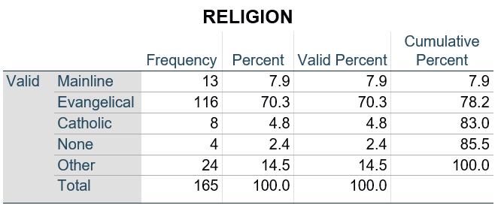
Faith Identity Test
For initial test
  N = 165 Participants (M=57; F=108)
  150 Freshmen, 12 Sophomores, 3 Juniors
  Completion time: < 5 minutes

Slide 40
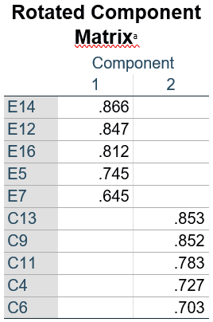
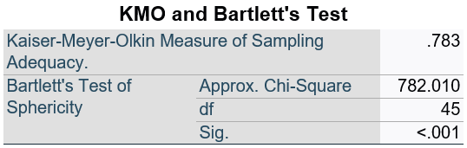
Faith Identity Test
Factor Analysis in SPSS revealed 2 Clear Factors after Varimax Rotation
The factors were clearly divided by question type
The Exploration and Commitment emerged as the factors
KMO and Bartlett’s values indicate sufficient strength to conduct a factor analysis and that data are normally distributed.

Slide 41
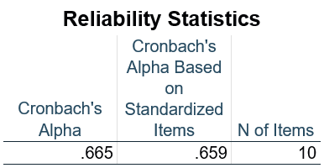
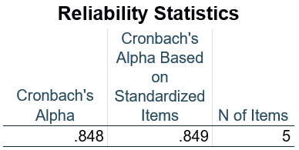
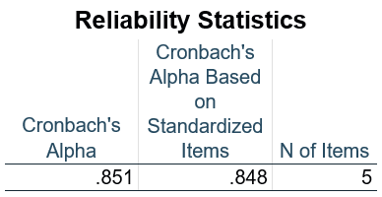
Faith Identity Test
Full Instrument
Commitment
Not only is the test as a whole indicated as Reliable due to high internal consistency, each subscale scored high on Cronbach’s Alpha as well.
Exploration

Slide 42
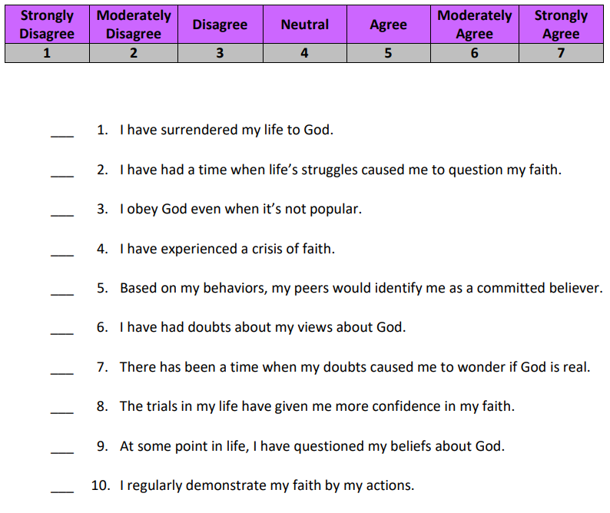
Faith Identity Test

Slide 43
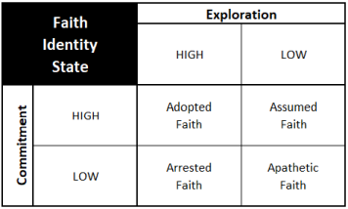
Faith Identity Test - scoring
Scoring and Results
Each Subscale has a minimum score of 5 and a maximum score of 35
Scores from 5-20 equate to LOW
Scores from 21-35 equate to HIGH

Slide 44
Faith Transforming Events
Explore what prior FTE’s have been experienced
Be sure to inquire about the process of exploration
  Who did they talk to?
  How did they respond?
This comes back to exploring their current location
It also comes back to understanding their previous experience

Slide 45
Babies and Bathwater
Lowercase "evangelicalism" (the baby) - represents the best of Foster's evangelical stream - a people who are in love with Jesus and deeply desire to tell others about Him and do good works in His name because of Him
Uppercase "Evangelicalism" (the bathwater) - the American church's infatuation with the Republican Party and with Donald Trump. More concerned about gaining and maintaining power than being the church that's described in the New Testament. Full of hypocrisy in judging the character of the Clintons and ignoring the character of Trump.
Summary - Don't throw the baby out with the bathwater!
  Also know that it's completely OK to throw out this bathwater.
  Just don't grab the other side's nasty bathwater to refill your tub!
Notes:
Foster’s Streams of Living Water – READ IT!

Slide 46
working: what do we do?

Slide 47
1. Pray for your people
And, Normalize the Questioning

Slide 48
2. Help them beware
McDowell and Marriott bring up Four Good Points:
Beware of fooling yourself - this has to do with intellectual dishonesty tied to confirmation bias
Beware of rejecting faith for shallow reasons - this has to do with leaving the faith altogether because remaining faithful is burdensome
Beware the temptation to go alone - this has to do with talking oneself out of faith without seeking counsel from others
Beware of anger becoming bitterness - this has to do with the fact that deconstruction often starts due to hurt and that the anger one feels isn't appropriately dealt with but has become a residual bitterness that hurts self and others.

Slide 49
3. Guide safe exploration
Providing a non-judgmental space to entertain deep questions.
How did you react a moment ago when I talked through babies and bathwater?

Slide 50
Faith Identity Test - Applications
CCCU University
Could be given to all incoming freshmen
Useful in identifying best fit for Introductory Spiritual Formation class

Slide 51
Faith Identity Test - Applications
Academic Research
Short instrument to divide faith members into groups
Useful in difference research (groups)
Subscale scores could be used in Correlation research

Slide 52
Faith Identity Test - Applications
Therapy Practice
Could be given to as part of intake
Useful in informing client’s spiritual “location”
Especially beneficial if client is struggling with spiritual matters (vocabulary to talk through FTEs; normalize questioning)

Slide 53
Faith Identity Test - Applications
Therapy Practice
Could be given to as part of intake
Useful in informing client’s spiritual “location”
Especially beneficial if client is struggling with spiritual matters (vocabulary to talk through FTEs; normalize questioning)

Slide 54
4. Recognize retreat mode
If emotional unrest gets too big, it can short circuit the process.
This anxiety-ridden pause might be someone’s location when they show up in your office.

Slide 55
5.Trust the holy spirit
It’s never our job or responsibility to talk someone into or out of the faith.
Trust the Holy Spirit to bring conviction where He’s working.
Our role is to aid in exploration.

Slide 56
Thank you!
Questions?

